Slide 1
Web Design & Development
Industrial Attachment

Slide 2
Title and Content Layout with List
Concept of Web Design and Development.
Materials.
Element.
Create a website using only table element of HTML (project-1).
Create a Carom Board using HTML & CSS.
Design a Website only using HTML & CSS.
Create a Website like Bangladesh.gov.bd using (HTML, CSS, Bootstrap).
Develop dynamic Website like Bangladesh.gov.bd

Slide 3
Web Design and Development
Web design and development is an umbrella term that describes the process of creating a website. Like the name suggests, it involves two major skill sets: web design and web development. Web design determines the look and feel of a website, while web development determines how it functions.

Slide 4
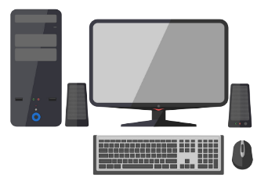
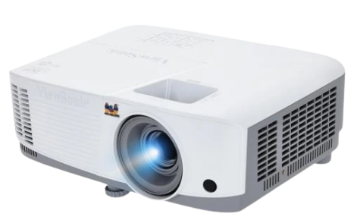
Materials:
Computer,
Keyboard,
Mouse,
Internet,
Essential Software,
Multi-media,
Projector

Slide 5
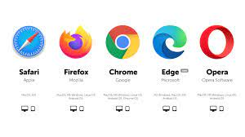
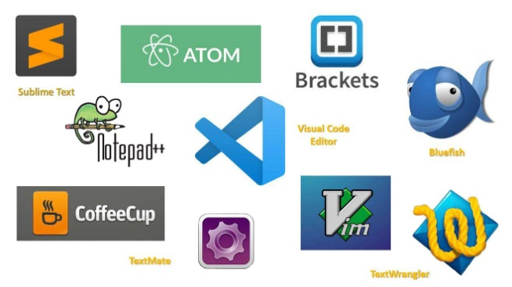
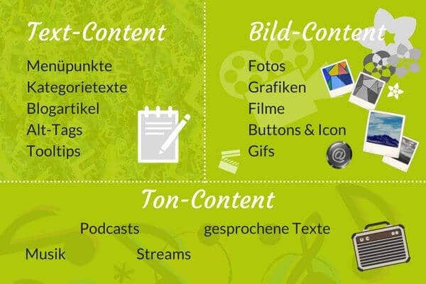
Element:
Browser
Code Editor
Content

Slide 6
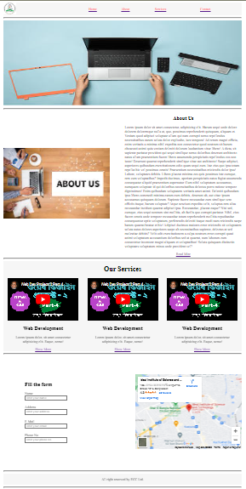
Create a website using only table element of HTML (project-1).

Slide 7
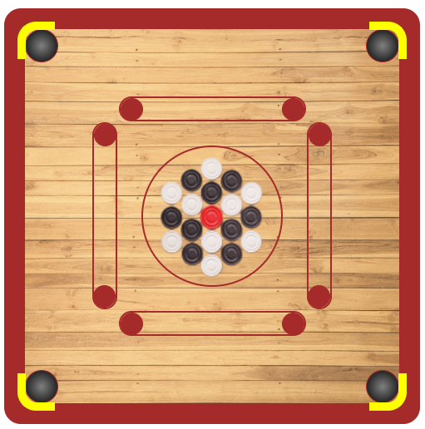
Create a Carom Board using HTML & CSS.

Slide 8
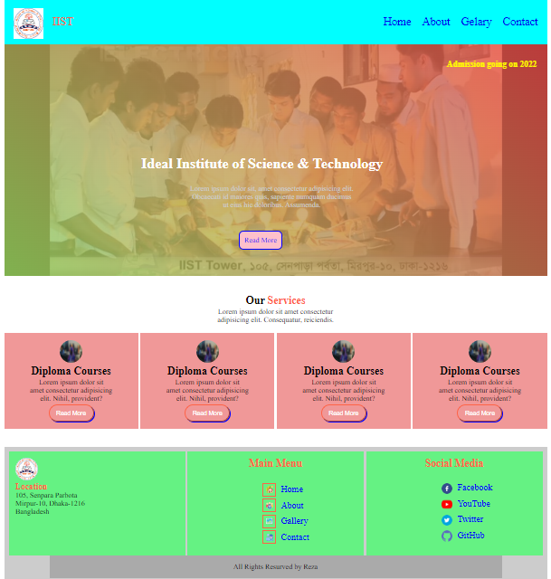
Design a Website only using HTML & CSS.

Slide 9
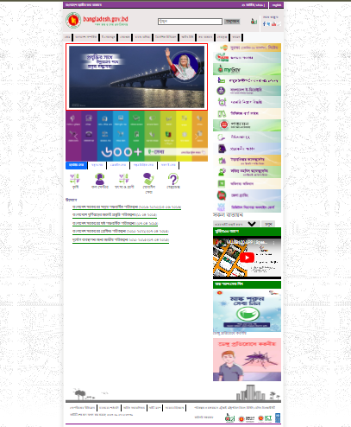
Create a Website like Bangladesh.gov.bd using (HTML, CSS, Bootstrap).

Slide 10
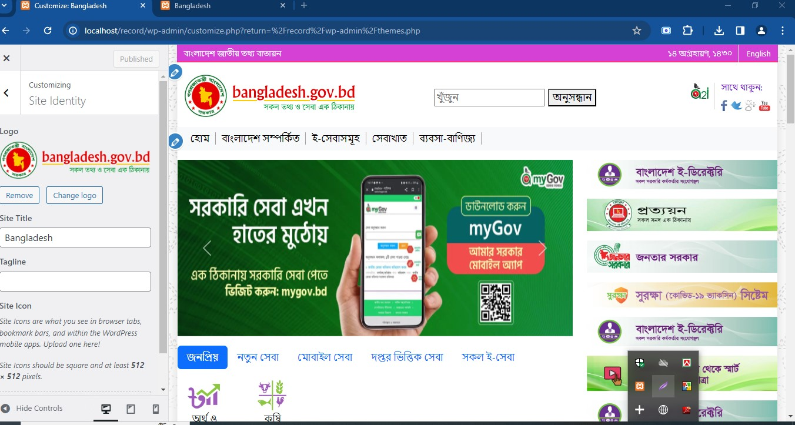
Develop dynamic Website like Bangladesh.gov.bd
Logo , Site title, Site icon change dashboard.

Slide 11
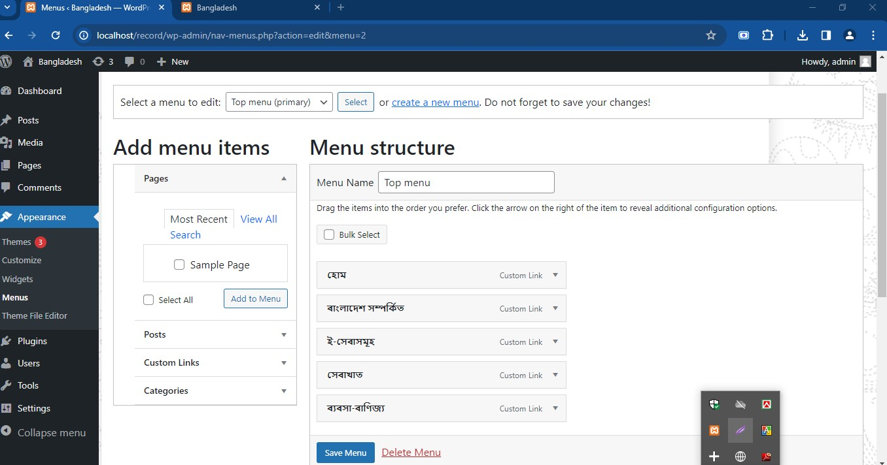
Develop dynamic Website like Bangladesh.gov.bd
Changing menu using admin section.

Slide 12
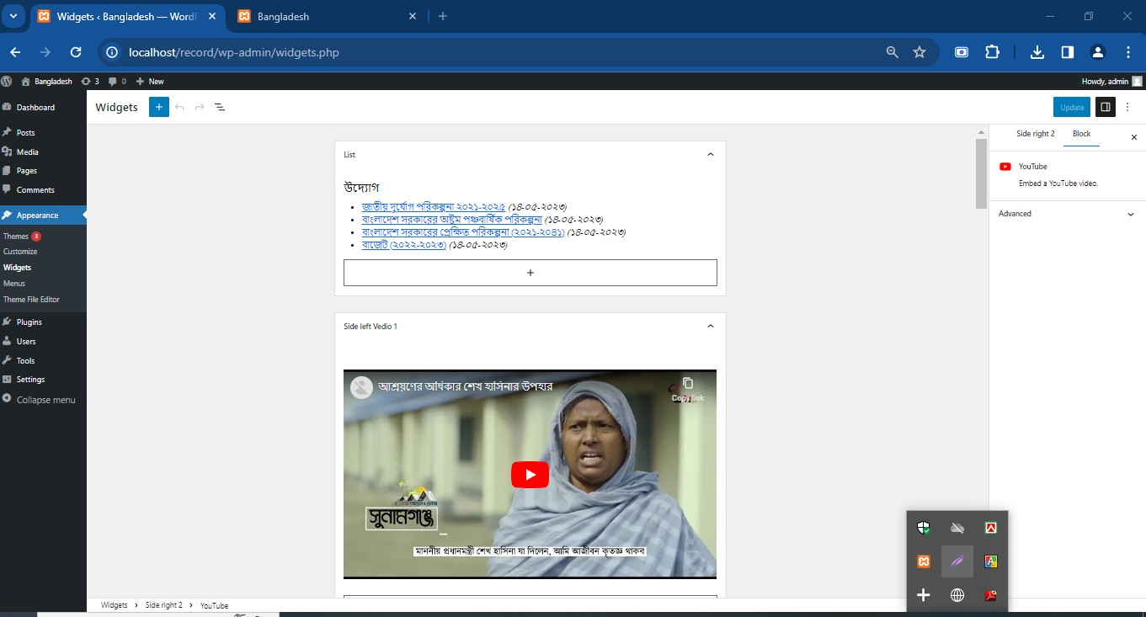
Develop dynamic Website like Bangladesh.gov.bd
Widget part for changing dynamic sidebar all part.

Slide 13
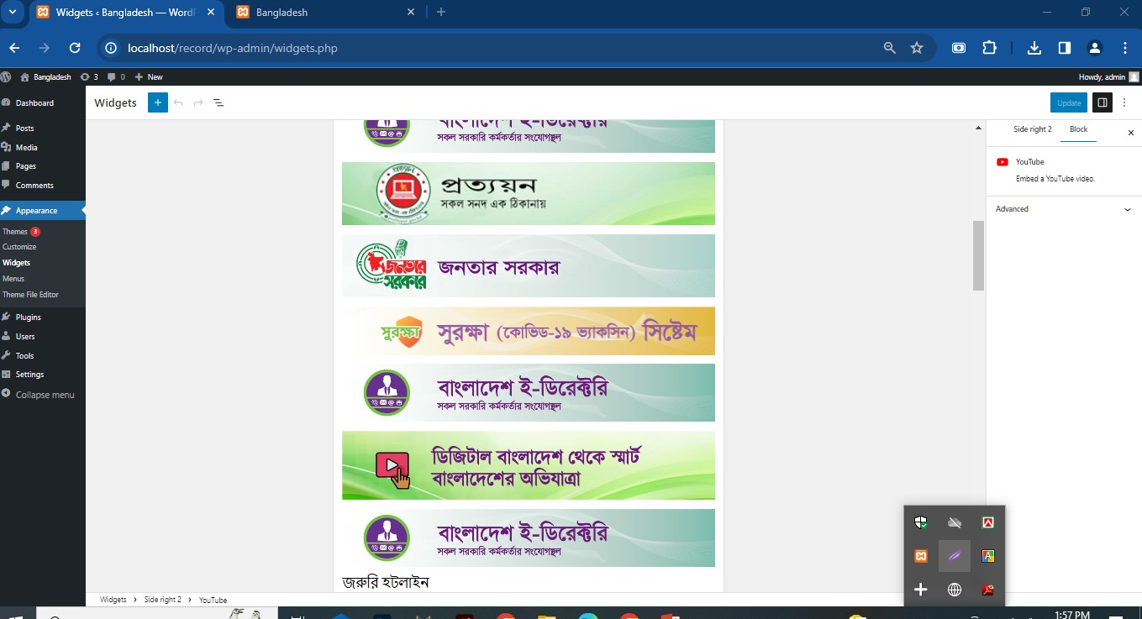
Develop dynamic Website like Bangladesh.gov.bd
Widget part for changing dynamic sidebar all part.

Slide 14
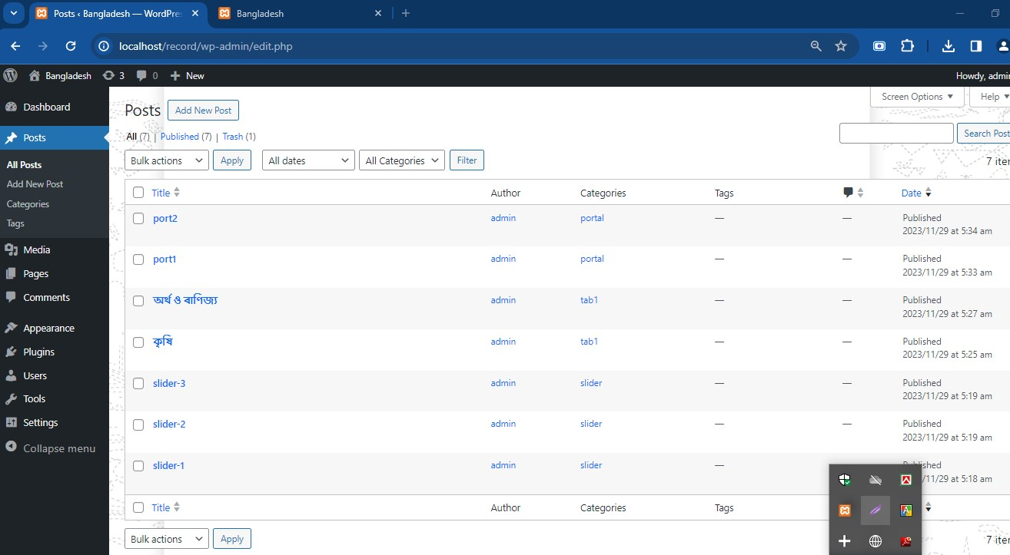
Develop dynamic Website like Bangladesh.gov.bd
Dynamic slider, tabs & portal part using while loop & have to post with the specific category.

Slide 15
Thank You!
Any question?

